Slide 1
Track & Field District Meet Director Webinar
May 1, 2025

Slide 2
Qualification for State Championships
All District Meets will follow 2025 NFHS Track and Field Rule 4-2-4(c) – “In meets which involve four or more schools, not more than three contestants from a given school shall be allowed to enter an individual event.”
6A – Top Two Placers from district meet, Two wildcards, Qualifying standards (16 minimum)
5A – Top Two Placers from district meet, Five wildcards, Qualifying standards (13 minimum)
4A – Top Two Placers from district meet, One wildcards, Qualifying standards (13 minimum)
3A – Top Two Placers from district meet, One wildcards, Qualifying standards (13 minimum)
2A – Top Two Placers from district meet, Four wildcards, Qualifying standards (12 minimum)
1A – Top Two Placers from district meet, Four wildcards, Qualifying standards (12 minimum)

Slide 3
Vertical Jump Maximum Starting Heights and Required Increments
Leagues/Districts may set a lower starting height but starting height may not exceed the height listed below. If lowering a maximum starting height, it must correspond to the increments listed in tables below. (Ex: the starting height is listed as 1.28m with increments of 5cm – you can go down to 1.23m, 1.18m, etc.)
Full increments can be found at the back of the DMD Info
High Jump – maximum starting height listed below; 5cm increments until the height shown; 3cm increments thereafter.
Pole Vault – maximum starting height listed below; 15cm increments until the height shown; 7cm increments thereafter.

Slide 4
High Jump Maximum Starting Heights and Required Increments
2025 High Jump Maximum Starting Heights - Increments
Classification | GIRLS |  | BOYS
 | Starting Height | 5cm Increment Until (3cm thereafter) | Starting Height | 5cm Increment Until (3cm thereafter)
6A | 1.32m | 1.57m | 1.58m | 1.83m
5A | 1.28m | 1.48m | 1.59m | 1.79m
4A | 1.20m | 1.45m | 1.59m | 1.79m
3A | 1.20m | 1.45m | 1.51m | 1.76m
2A | 1.22m | 1.42m | 1.51m | 1.76m
1A | 1.22m | 1.42m | 1.53m | 1.73m

Slide 5
Pole Vault Maximum Starting Heights and Required Increments
2025 Pole Vault Maximum Starting Heights – Increments
Classification | GIRLS |  | BOYS
 | Starting Height | 15cm Increment Until (7cm thereafter) | Starting Height | 15cm Increment Until (7cm thereafter)
6A | 2.56m | 3.31m | 3.19m | 4.24m
5A | 2.20m | 2.95m | 3.23m | 3.98m
4A | 1.94m | 2.69m | 3.15m | 3.90m
3A | 1.96m | 2.71m | 2.39m | 3.44m
2A | 1.62m | 2.37m | 2.44m | 3.34m
1A | 1.56m | 2.46m | 2.41m | 3.46m

Slide 6
Para-Athlete Reminders
There are two divisions for which a para-athlete may qualify, wheelchair participants and ambulatory. All athletes in grades 9-12 must meet OSAA eligibility requirements. For additional information see OSAA Handbook, Rule 8, Individual Eligibility
Para-Athlete Disability Certificate - Must be submitted to Kelly Foster with written doctor’s documentation of the athlete’s disability no later than 9pm, Saturday, May 24.
Events: 100M, 400M, 1500M, and Shot Put

Slide 7
State Championship Online Entry Form
It is imperative that district meet directors upload complete Varsity results to www.athletic.net/ using the instructions provided below – additional reminders include:
Please check entries and accuracy of information before submitting the entry. Please ensure that all entries are matched to the correct school and that you have included first name, last name, year in school (i.e. 9, 10, 11, 12 – NOT Fr, So, Jr, Sr) school, and mark of each qualifier.
For all relays, please list the four members of the team and up to two alternates. Please note the deadline for entering relay alternates.
If you use fully automatic timing (FAT) at your district meet, list the fully automatic times on the entry form. If you use hand times, please round up all times to the nearest 1/10, i.e., 26.50 rounds to 26.5 and 26.51 rounds to 26.6. The Hy-Tek program will automatically convert the non-FAT times for seeding purposes. DO NOT CONVERT.
To determine whether a participant meets the qualifying standard for an individual event, please see the Qualifying Standards for 2024 posted online.

Slide 8
Corrections Prior to Submitting
Results must be submitted no later than 9pm, Saturday, May 24. Once results are uploaded, you will not be able to delete and upload again or make corrections. Use OSAA Change Form with any changes after you upload results.
Athletic.net will then follow OSAA State Championship Qualification guidelines to advance athletes from each set of district meet results into the state meet, as entries. Once your results are uploaded and marked as official, the process of declaring entries will be done by Athletic.net’s State Meet advancement system.
Meet Directors will NOT need to individually submit the state qualifying entries. Athletic.net will handle everything once Official Results are posted. You must ensure that your results are accurately posted on Athletic.net no later than 9pm, Saturday, May 24.

Slide 9
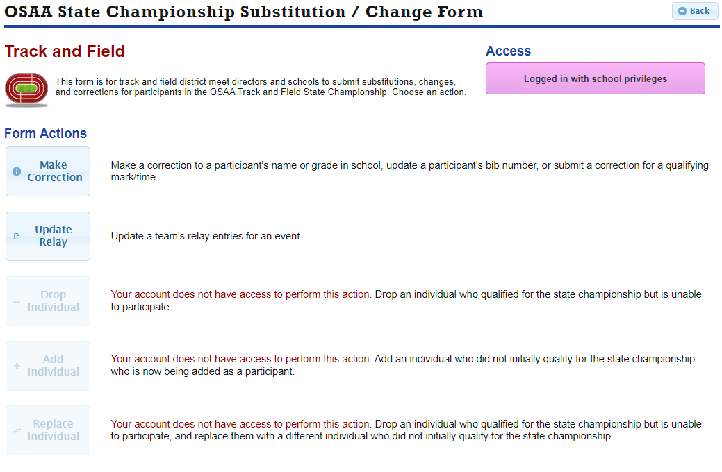

Slide 10
Posting Timeline
All entry names and marks for each event will be posted on the OSAA website, on Sunday, May 25 by 6pm.
District Meet Directors AND coaches of qualifying individuals are responsible for checking the accuracy of the entry information. Please check all entries, including Wild Cards, for correct spelling of participant’s name, year in school, school name, etc., as this information will appear the same way in the souvenir program unless corrected. Coaches should monitor the Wild Card Entry list if they have an athlete on it as changes do occur.
CONTINUE TO MONITOR WILD CARD ENTRIES DOCUMENT FOR UPDATES
Use OSAA Online Change Form to make changes

Slide 11
Multiple Event Qualifiers and Relays
This deadline is for a participant withdrawing from the championship in one event but remaining in others and for submission of up to six names for a relay team.
Multiple Event Qualifiers: Except as indicated below, participants who qualify in more than one event shall participate in all the events for which they qualify from preliminaries to finals.
If a District Meet Director notifies the OSAA of a change prior to 4pm on the Monday (6A, 5A, 4A, 3A, 2A, 1A – May 26) preceding the state championship, an individual may drop from one or more events in which they are qualified. The next place winner at the District Meet in the respective event or events is eligible as a substitute.
If the OSAA has not been notified of a change prior to 4pm on the Monday (6A, 5A, 4A, 3A, 2A, 1A – May 26) preceding the state championship, the participant who has qualified in multiple events must compete in all qualified events or they shall be scratched from all events in which the participant has qualified.

Slide 12
Relay Event Entries
Qualifying teams may enter the names of up to six individuals in relay events.
Qualifying relay teams failing to enter six individuals may not add individuals to the state championship meet after the established Monday 4pm (6A, 5A, 4A, 3A, 2A, 1A – May 26) deadline. However, after the established Monday 4pm (6A, 5A, 4A, 3A, 2A, 1A – May 26) deadline, any of the entered relay team members may be replaced by the Wednesday 4pm (6A, 5A, 4A, 3A, 2A, 1A – May 28) deadline by an athlete already in the meet. If only four or five relay members are entered by the Monday 4pm (6A, 5A, 4A, 3A, 2A, 1A – May 26) deadline, nobody may be added to the relay team.
Any four of the listed individuals may compete and it shall count as an event only for the four who compete.
Using OSAA Online Change Form

Slide 13
Single or Multiple Event Qualifiers Dropping All Events or Substitutions only on Relays
This deadline is for a participant dropping out of the state championship and being replaced by another participant or participants.
If a District Meet Director notifies the OSAA by 4pm two business days prior (3A, 2A, 1A – May 27) (6A, 5A, 4A – May 28) to the first day of the state championship that a single event or multiple event qualifier is dropping all events, a substitution or substitutions may be made.
The next place winner at the District Meet in the respective event or events is eligible as a substitute. If the athlete was a Wild Card qualifier then the next in line will be eligible.
Using OSAA Online Change Form

